Slide 1
Respiratory System
By
Dr. Hussein AlNaji

Slide 2
Principles of Respiratory Insufficiency
The principal function of the respiratory system:
1- Gas exchange in which oxygen is transferred from the environment to the blood and carbon dioxide is moved in the opposite direction.
2- A role in thermoregulation in most species.
3- In acid-base regulation in concert with the kidney
4- In functioning as an endocrine organ (e.g., angiotensin converting enzyme).
5- In the metabolism of metabolically active substances including eicosanoids and nitric oxide.
6- In the immune response to inhaled immunogens and pathogens.

Slide 3
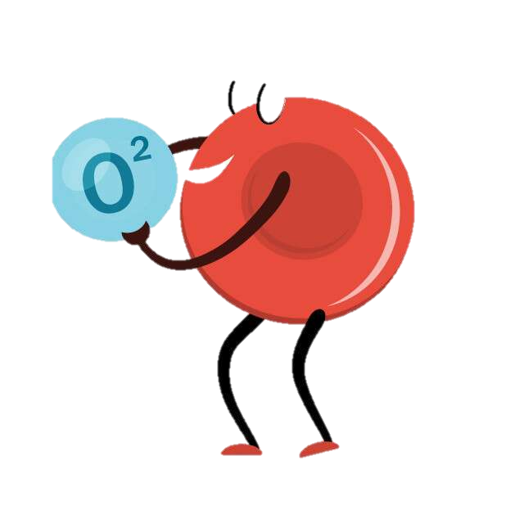
HYPOXIA
Failure of the tissues to receive an adequate supply of oxygen.
Occurs in a number of ways, and the differences are clinically relevant because they are associated with failure of different organ systems and different diseases, and they have fundamentally different pathophysiologic mechanisms

Slide 4
Hypoxic (or Hypoxemic) Hypoxia Hypoxic (or hypoxemic) hypoxia
Occurs when there is inadequate oxygenation of blood (hypoxemia) and is usually associated with disease of the respiratory tract or other causes of hypoventilation. Situations in which there is inadequate oxygenation of blood in the lungs include hypoventilation, ventilation-perfusion mismatches, diffusion impairment, low inspired oxygen tension, and extrapulmonary right-to-left shunting.

Slide 5
b- Anemic Hypoxia
Anemic hypoxia occurs when there is a deficiency of hemoglobin per unit volume of blood (anemia). The percentage saturation of the available hemoglobin and the oxygen tension of arterial blood are normal but as a result of the low hemoglobin concentration the oxygen-carrying capacity of the blood is reduced.
1- Anemia resulting from any cause has these characteristics.
2- Alteration of hemoglobin to pigments, such as in poisoning caused by nitrite converted hemoglobin to methemoglobin or carboxyhemoglobin du to poising with carbon monoxide, that are not capable of carrying oxygen has the same effect on oxygen content as anemia.

Slide 6
c- Circulatory Hypoxia
Circulatory hypoxia occurs as a result of inadequate delivery of oxygen to tissue because of inadequate perfusion of tissues by blood.
A common cause of this is low cardiac output,
1- congestive heart failure or hypovolemic shock.
2- local interruption to arterial flow, such as the thrombotic emboli of thromboembolic colic of horses
3- compression of vessels, such as in right displacement and torsion of the abomasum

Slide 7
d- Histotoxic Anoxia
Histotoxic anoxia occurs when oxygen delivery to tissue is adequate because both oxygen content of arterial blood and blood flow are appropriate, but the tissue is unable to utilize oxygen. Cyanide poisoning is the only common cause of this form of anoxia.
Consequences of Hypoxia
Consequences of inadequate delivery of oxygen include changes in almost all body systems. The central nervous system and heart are most susceptible to the immediate and acute effects of hypoxia, whereas clinical signs related to hypoxic damage to the gastrointestinal tract and kidneys are somewhat delayed.

Slide 8
CARBON DIOXIDE RETENTION (HYPERCAPNIA)
Respiratory insufficiency results in decreased elimination of carbon dioxide and its accumulation in blood and tissues.
Acute hypercapnia causes a respiratory acidosis that reduces both blood and cerebrospinal fluid pH. The clinical signs of acute hypercapnia are initial anxiety followed by central nervous system depression and eventual coma and death.
Respiratory failure
It is the terminal stage of Respiratory insufficiency in which the activity of the respiratory centers diminishes to the point where movements of respiratory muscles cease. Respiratory failure can be paralytic, dyspneic or asphyxial, or tachypneic, depending on the primary disease.

Slide 9
Principal Manifestations of Respiratory Insufficiency
The common signs of respiratory disease are as follows:
1- Abnormalities in the rate, depth, or ease of breathing
2- Lethargy or exercise intolerance.
3- Abnormal posture.
4- Abnormal lung sounds.
5- Abnormal respiratory noises.
6- Coughing.
7- Cyanosis.
8- Nasal discharge.
9- Epistaxis and hemoptysis.

Slide 10
Thank You

